Slide 1

MBC 638 Study improvement project
Maya Mileva

Slide 2


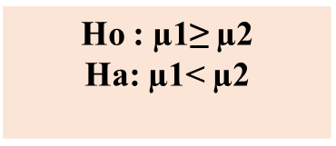
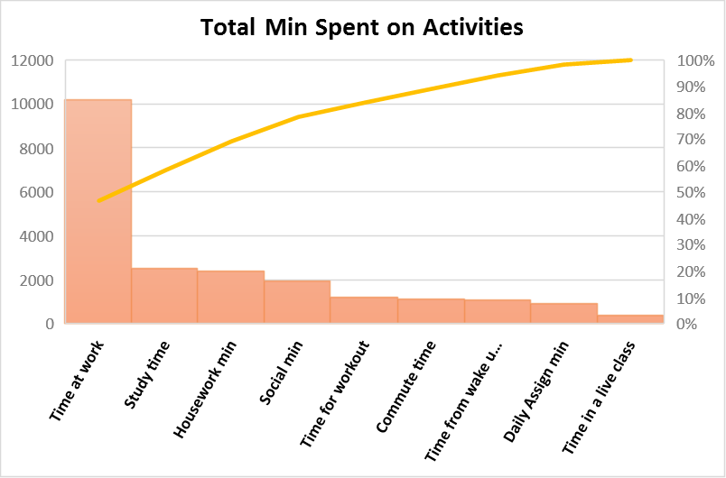
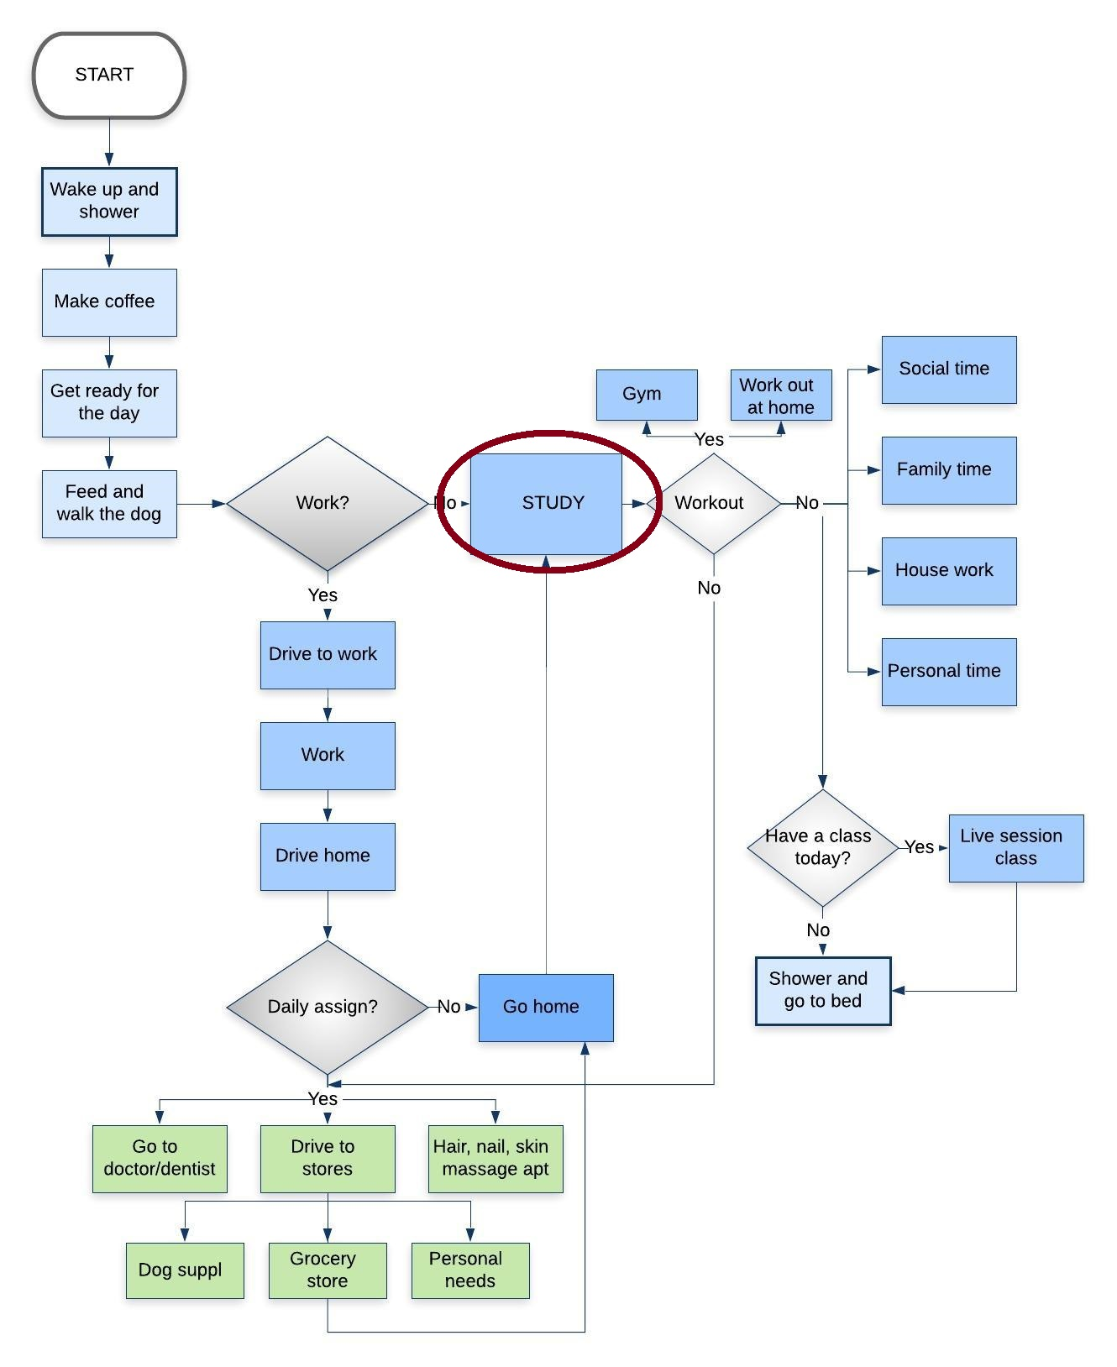
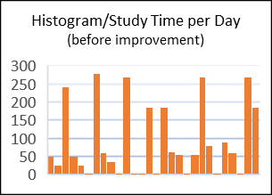
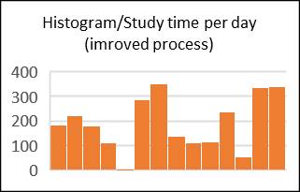

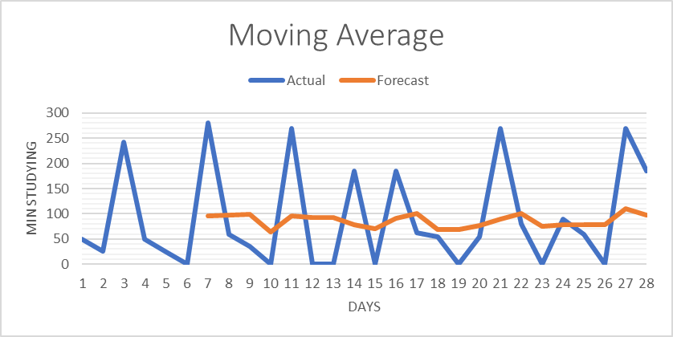
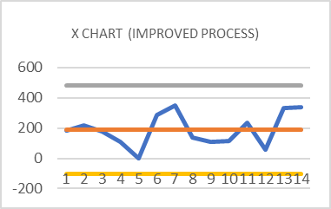

MBC638 Study Improvement Project
Process owner Maya Mileva
Key Dates--> Team Launch 1/9/2019 | Define 1/9/2019 | Measure 1/16/2019 | Analyze 2/13/2019 | Improve 2/27/2019 | Control 3/13/2019
DEFINE Problem Statement: Not enough time to study for MBC638. My every day schedule is really busy and that need to change in order for me to complete the class. | MEASURE | ANALYZE Hypothesis testing: | IMPROVE Changes made to the process:
Collected data on 13 variables. Study time(Y), Working(X1), Social min(X2), Workout min(X3), Daily assig(X4)...
Study time moved up in the process map Go to work early/get off early Study at least 180 min a day Quality studying, plan every day Limit social time, dally assig and other not important activities
SQL= 1.7
SQL=0.9
p=0.50 we can`t reject the Ho The results shows that Y (study time) still may not be a statistically significant to a 95% level of confidence that the before and after data is different.
Higher levels after improved
Can make prediction
ŷ=643.3033-0.9739timework-0.8684timeworkout-0.8911socmin-0.7675housewrkmin-0.9830dailymin
Significance F =3.02401E-08,
More time spent on working, studying(not quality studying), going out, working out and cleaning.
New process is in control
CONTROL
Business Impact: My benefit is going to be saving $5025 as well as personal satisfaction. Also, completing the class is going to bring me one step closer to graduating in 18 months. I will measure my success by meeting my goal.

Slide 3
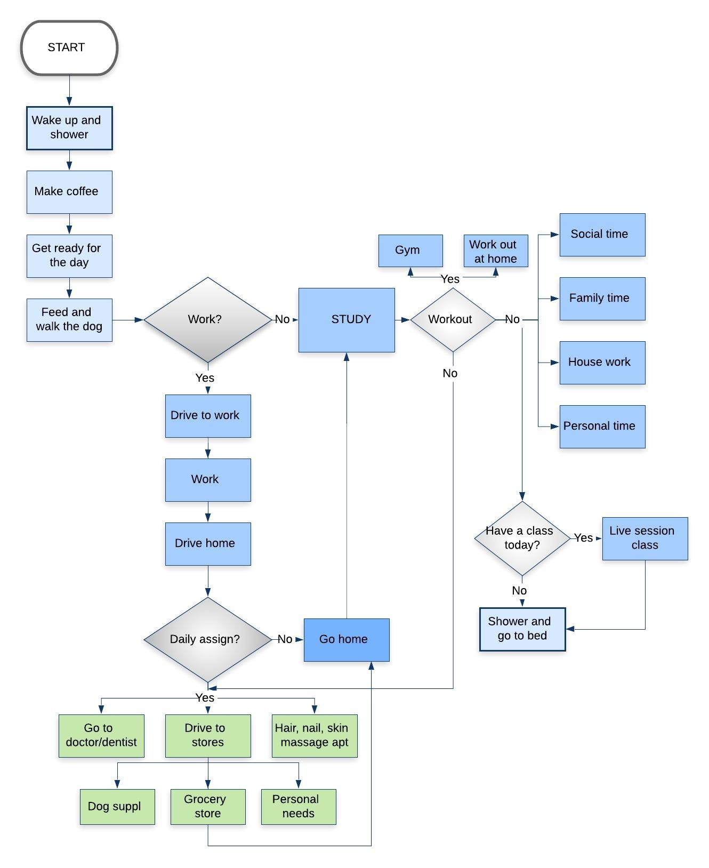

My study time is always after work, squeezed in between the rest of my activities. I am trying to fix the problem of me wasting a significant amount of time shopping, going out, reading extra document and not making notes. Also, my daily assign, and all the cleaning and cooking I do at home doesn`t let me spend enough time studying. I don`t have a fixed schedule for actual study time.
Current Process: Process Map
In order to understand my current process, I analyzed all my daily activities and created a process map.

Slide 4

Thought Process Map
The TPM is representing my thought process (questions, related actions and related decisions). Asking those questions gave me clarity on my process and where to look for the actual problem.

Slide 5
Data Measurement Plan
Performance Measure | Data Source and Location | How will Data be collected | Who Will Collect Data | When Will Data Be Collected | Target Sample Size
Waking up early or late every day | Maya`s cell phone time | Manual Data Collection | Maya | By 02/13/19 | 28 days
Min. from waking up to leaving the house | Clock at Maya`s house | Manual Data Collection | Maya | By 02/13/19 | 28 days
Commute time (min) | Maya, Maya`s car clock | Manual Data Collection | Maya | By 02/13/19 | 28 days
Time at work (min) | Work logging in and out data | Manual Data Collection | Maya | By 02/13/19 | 28 days
Total min. spent working out | Maya, gym or Maya`s house, call phone time | Manual Data Collection | Maya | By 02/13/19 | 28 days
Social min | Maya, multiple places, her phone time | Manual Data Collection | Maya | By 02/13/19 | 28 days
Count of miles driven | Maya, Maya`s car odometer | Manual Data Collection | Maya | By 02/13/19 | 28 days
Screen time (min) | Maya`s phone time, house | Manual Data Collection | Maya | By 02/13/19 | 28 days
Amount of time in a live class session | Log in and out class data time | Manual Data Collection | Maya | By 02/13/19 | 28 days
Leave work late or early | Maya`s phone, house | Manual Data Collection | Matt | By 02/13/19 | 28 days
Day of the week | Calendar | Manual Data Collection | Maya | By 02/13/19 | 28 days
Housework min | Matt, time on his phone, the house | Manual Data Collection | Matt | By 02/13/19 | 28 days

Slide 6
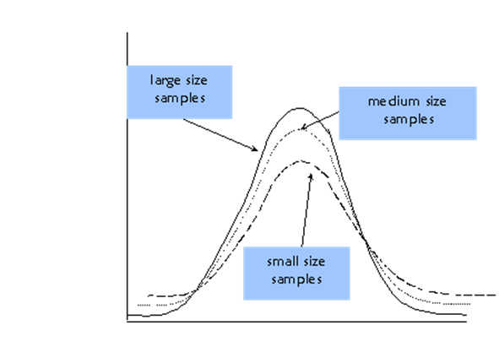

Sample Size
Sample size My total sample size is 28. With 95% confidence and margin of error 40, I would need at least 24 samples for my project. The calculation shows that I have collected enough samples for the project. Level of measurement error Sample size determination is the act of choosing the number of observations or replicates to include in a statistical sample. When I was inserting data in excel I could have put a wrong value, or another error could of came from me rounding the numbers. I tried to make the process systematic, inserted data in excel each day at the same time. My data is in minutes which made it easier when I was timing the activities. I tried my best to record the minutes at the end of each activity on my cell phone, or my tablet so I don`t miss anything or fake data. Measurement errors can be divided into two components: random error and systematic error. The random error can be minimized by assigning a partner to make sure the measurements are correct and consistent. Systematic errors may often be reduced with standardized procedures.
Sample size for continuous data: I have calculated my ideal sample size using the sample size formula. The level of confidence I pick is 95%, so α=0.05. z*=1.96(Z table, 95% confident, α=0.05/2= .025 1-.025=.975) My Y is continuous data, so I am going to use the formula: The margin of error is a measure of the precision of the confidence interval estimate. I am eager to accept E=40 min. Standard Deviation 99.5994(from excel) n = 1.96x99.5994/40=(4.8803706)^2 = ~24 (sample size have to be whole number)

Slide 7
Success Measures
Goal My goal is spending 20% more quality time a week studying for my class MBC638. I want to improve the way I study, make most of my time, by eliminating all the distractions.
Operational Definitions Y=amount of time(min) that I spend to study for MBC 638 every week for 4 weeks. Everyday I study less than 180 min is determined as a defect. These are the variables that will be included in my analysis, that are all instinctual items that I predict will influence the amount of time I study(y) or provide insight to the cycles of my data. Not all the variables will have strong impact, and will see that in the analysis, so can remove some of them later.
Early or late wake up – discreate data, added to the measured variables because I predict my days is going to be longer if I wake up early | Screen time min(study) - continuous data, that’s important variable, shows exactly how many min a day I study, which going to define my result
Time from wake up to leave the house – continuous data, if I leave work on time, I won`t be late and I don`t have to stay late working later | Amount of time in a live class - continuous data, I have class every week , and I have to attend it, which take away 90 min of my time
Commute time – continuous data, it is important for the analysis, because I spent a significant amount of time driving | Leave work late or early - discreate data, leaving work early gives me more time and vice versa
Time at work - continuous data, I have predicted that I spent most of my time working, sometimes even weekends, and that give me less time to study | Day of the week - discreate data, show the days on the week and weekend, the days I work or not, when I don`t work I have time to study
Time for workout – continuous data, working out is important to me and I can predict that the time I spent at the gym really can have significant impact on my process | Housework min – continuous data, indicates the time I spent cooking, cleaning, taking care of the house
Social mins – continuous data, time spend for dinners out, catching up with friend and not studying | Daily assign min – continuous data, all the time spent for shopping, dentist, for personal appointments, paying bills can affect the time I spend studying.
Miles driven – the more miles I drive each day, the less time I have

Slide 8
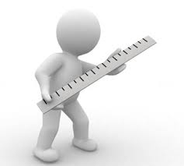
Success Measures
Measurement Process The Measurement process will include taking notes every day. It will start from the moment I wake up every morning and will measure my whole day – where, when and what time I spent for different activities. The measurement will be in minutes. After writing down the measurements of the time, they will be recorded in Excel. When updating the data each evening, I will also note the additional variables. My Excel table will include continuous as well as discrete data. The measurement will start every Monday each week and will continue for 4 weeks. I will start on that day, because of my working schedule. The discrete data measured will note the days I work or not, the days I am late for work etc. Continuous data will be min I work, social min, gym min etc. Each of the Measure, Analyze, Improve, and the Control phases will begin with our Monday evening measurements. I will run the measure process for 4 weeks. That`s going to give me data to create a baseline before making any changes. The improvement phase will be run for 14 days, starting Feb 27th . We’ll re-run our analysis with that data, and make our final change going into the control phase. The purpose of using 2 weeks for the Improvement and Control phase is to make sure there is enough data to provide us with statistically significant measurements, while still allowing time for analyzing and changing our process. Please note that in total we’ve continued collecting data past where the cut off was needed to complete our analysis. Data was continued to be collected for future analysis and future improvements.
Baseline I spent on average of 91 min per day studying for MBC 638 before improvement of the process. My SQL was 0.9 at very high DPMO of 714 285,72. My normal everyday schedule is not working anymore. I need to come with a plan how to plan my drive to work, time working, exercise hours, my lectures and homework, my social time, my family time in order to live normal life again.

Slide 9
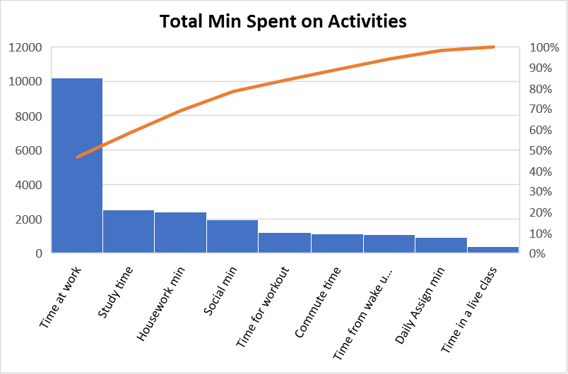
Current process: Pareto Chart
Pareto Chart is used to separate the vital few from trivial many. The vital few are the few factors accounting for the largest part (%) of the problem. Pareto Principle: 20% of the sources cause 80% of the problem. The chart is going to help me focus on my key problem(s), it is going to show me where I spend my time.
Results The charts shows that I have spent more time on working, going out and doing housework. Study time is in the 80% but is very close to the rest of the activities in that area of the chart. I should pay more attention to time at work(I can not change a lot there), my social min, housework and even working out min when I redesign my process.

Slide 10
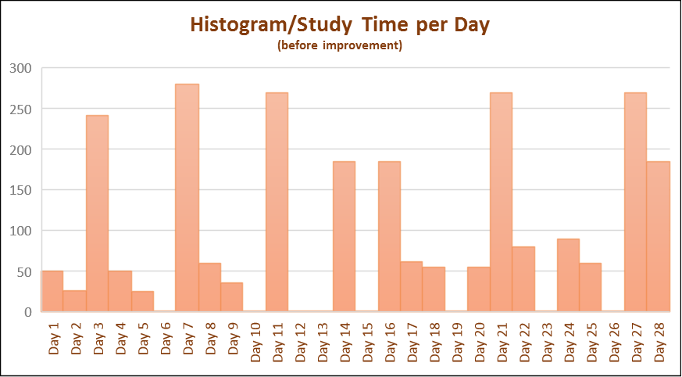
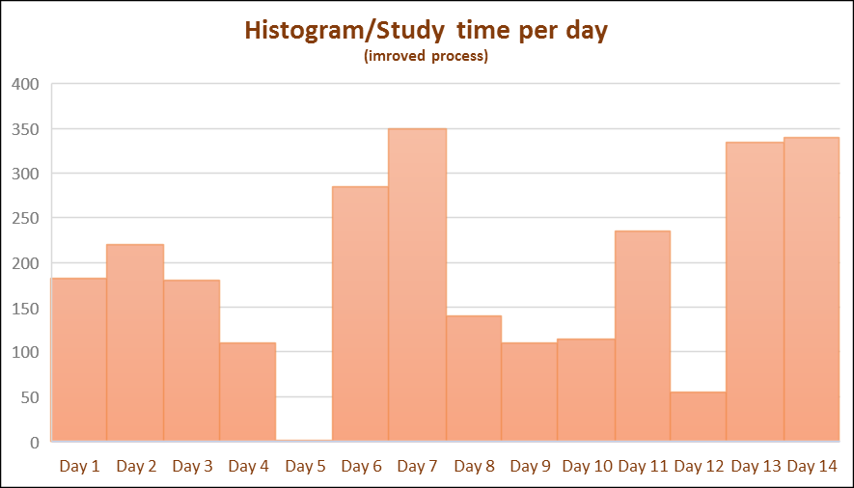
Histograms
Histograms are used as a graphical method of displaying the distribution of the my data by bar graphing the number of units in each category and gave me an idea how spread out my process is before and after he improvement.
Result My data is still spread out but with higher levels. After improvement there`s only one day without any time spent on studying(0.25 aver.time not studying a day before, and 0.072 after). There is tendency of increase every 7th day(Sunday). After improvement the big difference from day to day are minimized.

Slide 11
Descriptive Statistics
Descriptive statistics is used to measure central tendency and dispersion in the dataset before and after process improvement.
Result We can notice that in the new process the mean and median have increased. The mode shows that the most frequent study min increased from 0 to 110 which is significant. The standard deviation is increase which mean the new process has greater dispersion(the data become more diverse after the changes). That might be caused by the sudden change in the process.

Slide 12
SQL (Sigma Quality Level)
In simple terms, process sigma is a measure of the variation in a process relative to customer requirements. SQL draws the baseline for a process and measure a success after improvement. I used SQL(Sigma Quality Level) to indicate how often defects are likely to occur in my process and get clear idea how good the whole process is. I have calculated SQL before and after improvement. The data has been collected for 28 days. I have defined as a defect any day I study less than 3 hours(180min) so I have 1 possible defect per day.
Before Improvement
Defect per day: D=1 Units: U=28 Total possible defects : D x U = 1x28 = 28 Total actual defects(from my Excel table): A = 20 Defect per opportunity rate: A/DU = DPOx100 = 71,428572% DPMO = DPO x 1 000 000 = 714 285,72 SQL value from the table: 0.9
After Improvement
Defect per day: D=1 Units: U=14 Total possible defects : D x U = 1x14 = 14 Total actual defects(from my Excel table): A = 6 Defect per opportunity rate: A/DU = DPOx100 = 42.857143% DPMO = DPO x 1 000 000 = 428 571, 43 SQL value from the table: 1.7
Result From the calculations we can see that SQL after improvement is higher, which means that the process IS more capable of meeting your requirements based on my defined defect. Before it was 0.9 and after is 1.7.

Slide 13
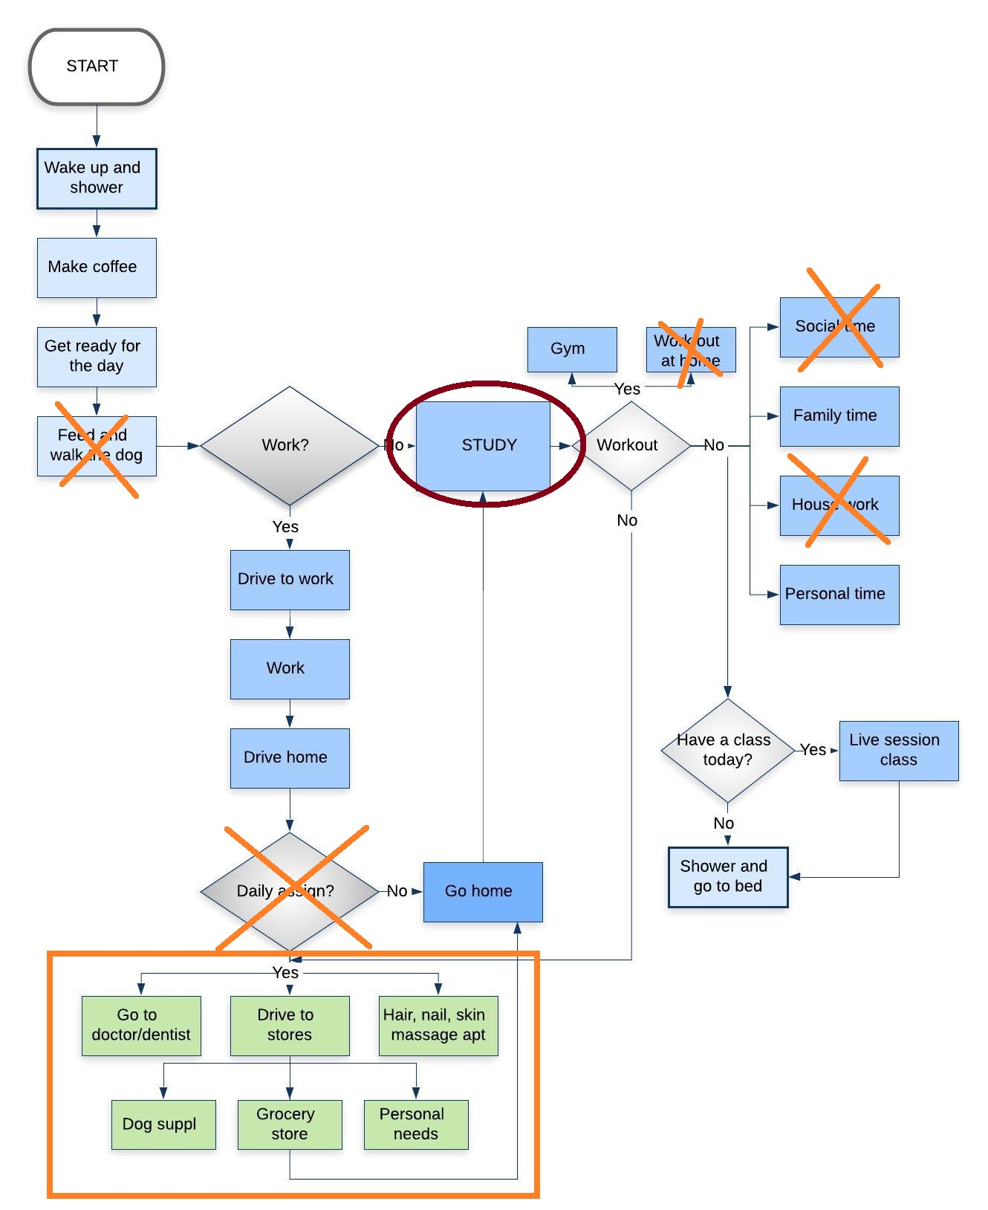
Process Changes
After analyzing the 4 weeks data for the old process, it was clear that wasn`t working for me and something had to be done to improve it.
* The process map is way too long, I have all these activities to fit in a day. I am going to change my priorities to put study time first so it move up in my process map before all the daily assign(if I have to do any). * I have to start getting up earlier in the morning so I don`t get stuck in traffic(average 50 min a day). That going to let me do my work faster and get off earlier . Pareto chart showed that I spend most of my time at work. * SQL showed high level of defect(study time <180 min a day). To increase SQL I will make sure I study at least 180 min a day before I start my workout or go out, or engage in any other activity. * Pareto Chart showed that top activities are working, social min, working out, housework min and study. (80/20 rule). Reviewing the data table for this variables I notices that I have been working Saturdays and overtime, as well as I had to many appointments and I have been going out way to much considering the work and study situation. Also my study time was in the 80% but I haven`t accomplished much studying. I am going to take notes, so I can make most of my time, do my homework right away. I must limit my social time to 1-2 times a week. I am going to stop working overtime. The housework is going to be my partner`s job for most of the time. I am going to make sure I set my appointments in one days so I don`t waste more time on that. *I am going to prepare a fix schedule and I have to stick to it, in order to make most of my day *Histograms shows 8 days without any studying at all. I am going to make sure that doesn`t happen again, I have so spend time to study every day.

Slide 14
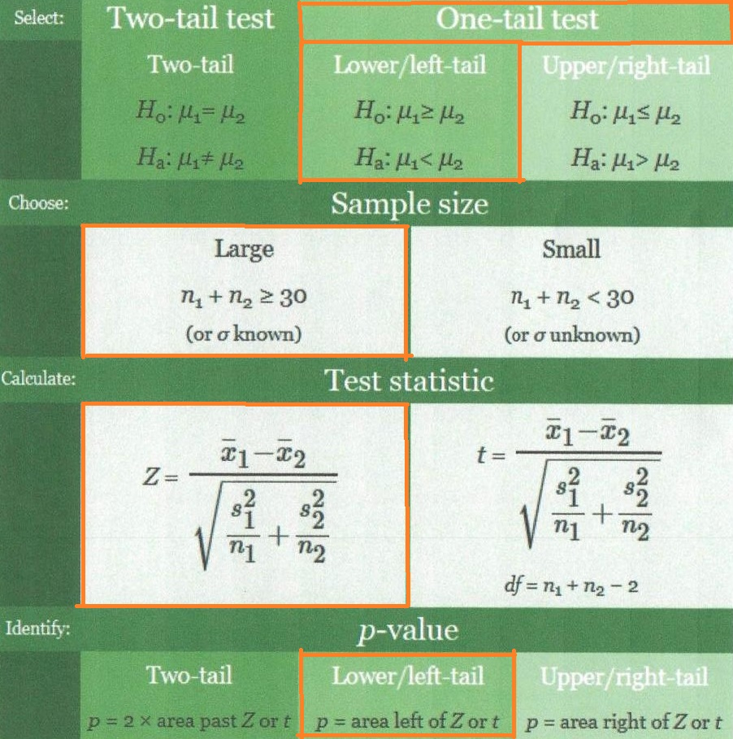
Hypothesis Testing
Hypothesis testing is used to determine if I have improved my process by making all the changes. The testing ensures the entire research process remains scientific and reliable. Determines statistically whether or not there is a cause for concern or if our conclusion is simply due to random variation. Ho – null hypothesis Ha – alternative hypothesis (what we want to happen) We have continuous data(min). Is the mean time for process Study Time for MBC638 for my new and improved process µ2 really more than my original process µ1?
Two-sample Hypothesis Test for Continuous Data
Ho : µ1≥ µ2 Ha: µ1< µ2
I picked one-tail two sample lower left-tail test. n1= 28 and n2=12 so n1+ n2=40>30 (large sample size) x ̅1=90.57 x ̅2=189.79 S1 = 99.60 S2 = 109.72 𝛼=0.05 (I want to be wrong just 5 % of the time) = -2.3925578297 = 0.0084 =NORM.S.DIST(0.0084, TRUE) P = area left of Z p=0.50 we can`t reject the Ho The results shows that Y (study time) still may not be a statistically significant to a 95% level of confidence that the before and after data is different.

Slide 15

Chi-Square – Test for independence
Chi-Square is used to determine if two classification variables are related, testing the statistical independence of two random variables. In this process is used to determine whether being a week day(M-F) or weekend day(S-S) has relationship with my study time(y). Discreate data is going to be used. Figuring that out is going to lead me to a conclusion if I need to spend more time to study during the week or the weekend. We don`t know what kind of relationship is, just if there`s a relationship. Negative aspect is that we have discreate data, so we need a lot of points.
Results
We have a p-value = .01 which is low and < .05 so we can reject our Ho and conclude that we can verify our claim and say that there is relationship between study time and day of the week.
Usually S-S I don`t go to work so I have more time to spend on all my activities. The time during the weekend can be used for optimizing my study time process.
Hypothesis Statement
Ho: Study time and day of the week are independent(there`s not relationship)
Ha: Study time and day of the week are not independent(there`s a relationship)

Slide 16
Regression analysis (Before improvement)
Regression is a way to see if my output and input variable are related and determine the strength of that relationship. My goal is to see which independent variables has impact on my process so I can improve them later. It is a way to model or predict the relationship between those variables.
Results
I ran the regression with all the variables and after I examined their p-values I choose the one with p<0.05. I concluded that there is relationship between time for work, social min, time for workout, housework min and daily assign min. After that I ran my regression with just those variables.
ŷ=643.3033-0.9739timework-0.8684timeworkout-0.8911socmin-0.7675housewrk min-0.9830daily min
Significance F =3.02401E-08, so that means that we can reject the Ho and that at lest one variable is good. Significant p-value does not mean that all the x`s has significant influence of y. Low F value means that we have a good model.

Slide 17
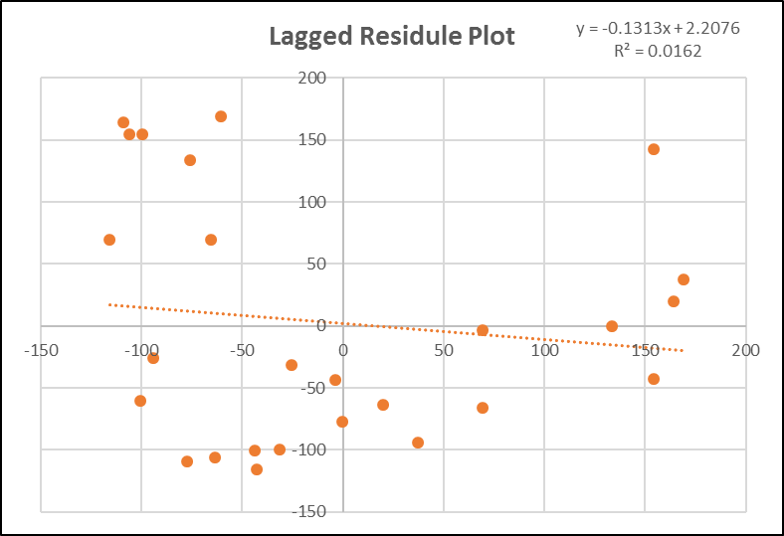
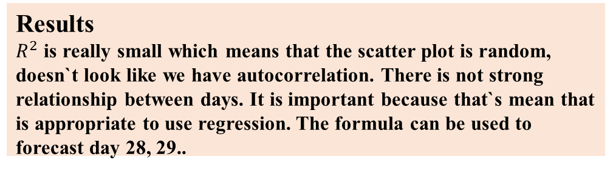
Autocorrelation
Autocorrelation is used to determine if there`s a relationship between neighboring points, which can cause lack of randomness in my data(residuals). Autocorrelation in my residuals is going to give me opportunity to improve the fit. Y=F(Y) – we only work with y.
Results
$R^{2}$ is really small which means that the scatter plot is random, doesn`t look like we have autocorrelation. There is not strong relationship between days. It is important because that`s mean that is appropriate to use regression. The formula can be used to forecast day 28, 29..

Slide 18
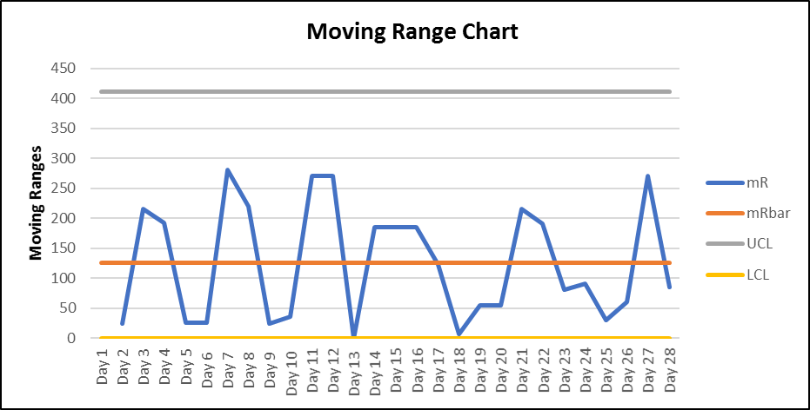
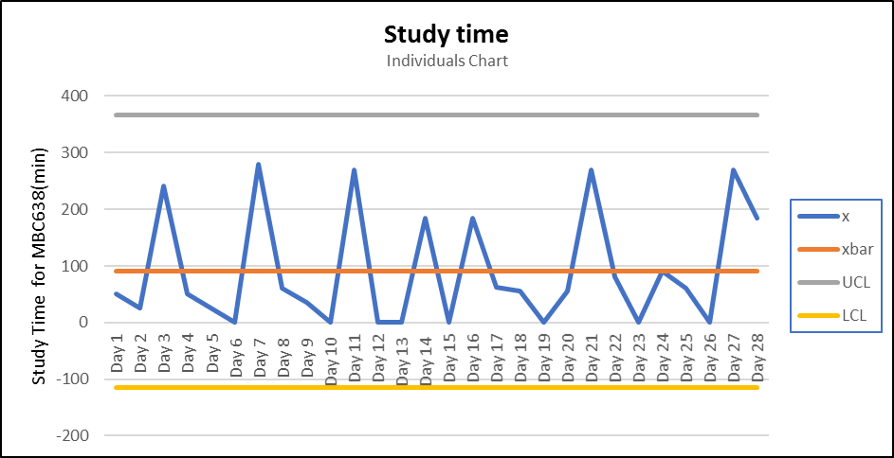
Control Charts
“Just because a process is in a control does not necessarily mean that it is a good process.” -Basic Statistic, Kiemele, Schmidt, and Berdine
Control Charts can be used as a statistical tool for problem identification as well as, ongoing monitoring of a process. We used them to evaluate our process. They can assist in distinguishing random variation(noise) from assignable variation(signal).
Results
Process looks in control, the data is in the control limits and look random.
We can conclude that the process run normal, and is going to continue to do so. If I am not happy with the results of that process, and I don`t change it, I`m going to keep on getting the same results.

Slide 19

Conclusion summary
My goal was to increase study time by at least 20 %. I am happy to see the results from the final changes made during the control phase; we saw an increase from the baseline. The weekly average study time increase from 91 minutes to 190 minutes daily. The project was very interesting, it provided some great insight to my current lifestyle, gave me clear understating where and how I spend my time and how I can manage it differently so I can get the most out of it. I think this project thought me some good lessons that will be useful in future. Looking back on the process I would have liked to incorporate other variables into the analysis and seen how making some other changes could affect the outcome. The hypothesis test showed that Y (study time) still may not be a statistically significant to a 95% level of confidence, that the before and after data is different. On the other hand SQL changed from 0.9 to 1.7 which means that I made my process more capable of meeting my requirements of 180 minutes a day of study time. TPM helped me get to the bottom of the problem, asking myself all the questions for activities. Pareto chart results helped identify the main spending time activities and later I focus on them and I found I way to remove or minimize them. Changing my priorities was the key point. Chi square showed that I actually spend more time studying during the weekend. Using regression I found out the impact and the strength of the independent variables on my Y. My process was in control from the beginning, but it wasn`t working right, I wasn`t happy with the results from it so I had to change it. With the regression I figured out that at least one of my variables was good. I had to consider measurement error, which could of gave me wrong results in my process alteration. I hope following the process helps me graduate from masters degree successfully and with good grades. Also, not to stress out about not having enough time for school made my life so much easier and my results better.

